Slide 1
Orthographic Gaussian Splatting for Volumetric Anatomical Visualization
Tasrefee Mahmood Ridun
200042150
MD Mushfiqur Rahman Mushfique
200042160
Kazi Jawadul Islam Jishan
200042165
Under the supervision of:
Tareque Mohmud Chowdhury Assistant Professor Department of Computer Science and Engineering (CSE) Islamic University of Technology (IUT), OIC

Slide 2
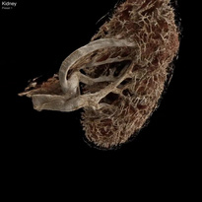
Research Objectives & Questions
Research Objective: Investigate the
feasibility of using Gaussian splatting for 3D visualization of medical imagery (CT scans).
Research Questions:
How can Gaussian splatting be
adapted for medical imaging?
What challenges arise in terms of
camera calibration and image
alignment?
Can Gaussian splatting improve the
accuracy of 3D reconstructions
compared to traditional methods?

Slide 3
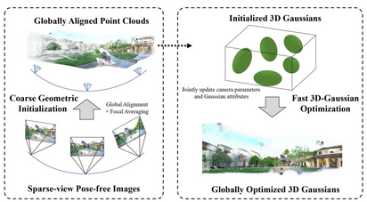
Introduction to Gaussian Splatting
What is Gaussian Splatting?
A technique for rendering 3D data by representing points in space as Gaussians. Commonly used in computer graphics for realistic visualization and mo deling.
Why it’s important for medical imaging?
Could offer a dynamic, interactive way to visualize complex medical datasets, such as CT scans.

Slide 4
Primary Elements of a Gaussian Splat
A Gaussian splat consists of the following primary elements:
Mean (Center): The central location of the Gaussian
function in the 3D space, typically defined as the position of
the splat. Covariance Matrix (Shape): Describes the spread and
orientation of the Gaussian distribution. It defines how the
splat will deform and influence surrounding areas. Weight (Intensity): The magnitude or intensity of the splat,
which determines its effect on the surrounding environment.
A higher weight results in a stronger influence. Radius (Spread): The spatial extent of the splat, typically
defined by the standard deviation of the Gaussian. A larger
radius means the splat has a broader influence, while a smaller
radius creates a more focused splat.

Slide 5
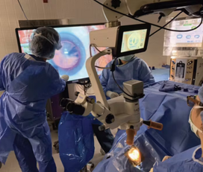
Research Motivation
Current Challenges in Medical Imaging:
3D visualization methods for medical data are limited. Traditional rasterization techniques often fail to provide sufficient detail or realism.
Goal:
To explore if Gaussian splatting can
address these limitations by offering
a more realistic and flexible way to
visualize 3D medical data.

Slide 6
1. Cinematic Gaussian Splatting (Cinematic GS)
Cinematic GS compresses large CT/MRI anatomy scans into lightweight 3D Gaussian representations, enabling real-time, photorealistic rendering. High-resolution scans are rendered offline using path tracing, then optimized using techniques like Mip-splatting for level-of-detail optimization. These compact models, typically under 70 MB even for multi-gigabyte datasets, maintain fine details comparable to the original voxel resolution and can achieve 60 FPS rendering on mobile or VR hardware. The pipeline involves selecting camera poses for anatomical structure capture, differentiable rendering training and model compression (e.g., via vector quantization).
Strengths: High fidelity, compact memory footprint.
Limitations: Baked rendering parameters (transfer functions,
lighting), requiring separate models for changes.

Slide 7
2. GaSpCT (Gaussian Splatting for CT)
GaSpCT applies 3D Gaussian Splatting to sparse-view CT reconstruction. Key techniques:
Specialized loss functions like beta sparsity and total variation
loss for foreground/background separation.
Uniform Gaussian initialization based on the expected
anatomy.
GaSpCT avoids traditional Structure-from-Motion (SfM)
approaches, allowing for interpolation between views, reducing
scan time, and minimizing radiation exposure without sacrificing
image quality.
Strengths: Efficient training and reduced scan burden.
Limitations: Primarily validated on simulated data, with
real-world challenges (e.g., patient motion, curved detectors) not
fully addressed.

Slide 8
3. Multi-Layer Gaussian Splatting
Multi-Layer GS builds on the cinematic approach, enabling immersive VR exploration of anatomy using layered 3D Gaussian models. The method trains Gaussian splats in stages:
Render the scan using one transfer function (e.g., bones) and
train the first layer.
Render with a second transfer function (e.g., muscles) and
train the second layer.
Prune inactive Gaussians and cluster similar ones across layers
for compression.
During VR rendering, users can toggle, clip, or combine layers
without retraining, enhancing the interactive experience.
Strengths: Interactive frame rates on VR hardware with good
anatomical detail.
Limitations: Static model structure, potential artifacts when
overlapping layers or zooming into low-contrast regions.

Slide 9
Comparative Summary of 3D Gaussian Splatting Methods
Asp ect Purp ose
Cinematic GS
Real-time photo- realistic rendering High-resolution
CT/MRI scans
<70 MB
GaSpCT
Sparse-view reconstruction Sparse X-ray pro-
jections
Variable, depends
on dataset
Reduced
time, low radia-
tion exposure
Validated on sim-
ulated data only
Multi-Layer GS
Immersive VR ex- ploration CT/MRI scans
CT
Input Data
Model Size
Varies based on
layers
Interactive
Strengths
High fidelity, low
memory footprint
VR,
good anatomical
detail
Static
structure,
ble artifacts
Interactive frame
rates
scan
Fixed
parameters
rendering
Limitations
model
possi-
60 FPS on mo-
bile/VR hardware
High quality, de-
pends on recon-
struction
Low
Rendering Per- formance
Interactivity
Low
High, toggle lay-
ers in VR
Layer-based prun-
ing and clustering
Compression
Mip-splatting,
None (sparse data
input)
vector
tion
quantiza-
Table: Comparison of 3D Gaussian Splatting Methods in Medical Imaging

Slide 10
Comparison with Base Gaussian Splatting Pipeline (Part 1)
Asp ect
Base
Gaussian
Cinematic GS
GaSpCT
Multi-Layer GS
Purp ose
Splatting General-purp ose
Real-time photo-
Sparse-view CT reconstruction
Immersive exploration
VR
Gaussian ting for 3D data visualization Full 3D volumet-
splat-
realistic ing
render-
High-resolution
CT/MRI scans
Input Data
Sparse projections
X-ray
CT/MRI scans
ric
data
(e.g.,
Use Case
voxel grids) Visualization of 3D volumes
Medical render-
Medical
reconstruction
CT
VR
anatomical
ing,
ism for VR
photoreal-
exploration
(medical, logical, etc.) General-purp ose flexibility
with
reduced
geo-
High
compact
resentation,
mobile/VR ren-
dering
Fixed
parameters
fidelity,
rep-
scan time
Reduced
time, low radia-
tion exposure
Strengths
scan
Interactive
VR,
multiple anatomical lay- ers
Static
model,
possible artifacts
with zoom
Limitations
High memory us- age, slower ren- dering for large volumes
rendering
Validated simulated only
on data
Table: Comparison of 3D with Base Gaussian Splatting Pipeline (Part 1)

Slide 11
Comparison with Base Gaussian Splatting Pipeline (Part 2)
Aspect
Base
Gaussian
Cinematic GS
GaSpCT
Multi-Layer GS
Splatting Moderate dering depends dataset size
Performance
ren- speed, on
60 mobile/VR hard- ware
FPS
on
High quality, de- pends on sparse data
Interactive frame rates in VR
Interactivity
Low interactivity
Low interactivity
Low
ity, static models
interactiv-
High interactiv- ity, layer toggling Layer-based pruning
clustering
Compression
Mip-splatting,
vector quantiza-
tion
None
data input)
(sparse
None,
Gaussian fitting
standard
and
Table: Comparison of 3D Gaussian Splatting Methods with Base Gaussian Splatting Pipeline (Part 2)

Slide 12
Metho dology
Dataset Selection:
Raw CT slices (hip-CT, 1800 images) chosen after evaluating available datasets. Converted from JPEG2000 to PNG via TIFF format.
Codebase Adaptation:
Adapted Gaussian Splatting pipeline to work with medical data. Resolved dependency conflicts with CUDA, PyTorch, and Visual Studio.
Structure-from-Motion (SfM):
Used M60 tank dataset to generate camera extrinsics due to challenges with CT slices. SfM couldn’t correlate CT images; switched to a non-medical dataset to test pipeline.
Gaussian Splatting:
Initial point cloud generated, but results were blurry. Adjusted camera extrinsics for orthographic projection, leading to more structured output.

Slide 13
Pipeline Setup
Pipeline Source:
Retrieved codebase from Gaussian Splatting for Cinematic Anatomy.
Dataset:
Used 1800 slices of CT scan images (hip-CT), converted
to PNG format.
Code Adaptations:
Addressed missing dependencies and removed deprecated
co de.
Testing:
Successfully ran Gaussian splatting on M60 tank dataset
to validate pipeline.

Slide 14
Dataset Selection & Preprocessing
Dataset Selection:
Initially explored X-ray and CT datasets but faced compatibility issues. Chose hip-CT, a dataset with 1800 slices of brain imagery (partial side).
Preprocessing:
Converted raw CT scan images from JPEG2000 (
format to PNG (8-bit).
Used JPEG2000 and TIF formats for intermediate
conversion.
JP2)
Data Compatibility:
Adapted dataset for Gaussian splatting pipeline by
resolving file format issues.

Slide 15
Structure-from-Motion (SfM) Challenges
SfM Requirements:
SfM typically requires common features (edges or textures) across images for camera extrinsics calculation. Essential for generating 3D structures, such as point clouds, from 2D slices.
Challenges with Medical Datasets:
CT Slices: Medical CT scan slices lack common features between adjacent slices (e.g., no shared edges or textures). Difficulty in aligning and correlating images for SfM due to the uniform nature of medical imaging.
SfM Failure on hip-CT Dataset:
Attempted SfM on 1800 slices from hip-CT dataset resulted in only 2 images being correlated. The absence of detectable features across slices prevents effective 3D reconstruction.
Alternative Approaches:
Explored using non-medical datasets (e.g., M60 tank)

Slide 16
Exploring Alternative Datasets
Challenges with Medical Datasets:
Medical datasets (e.g., hip-CT) lacked common features required for Structure-from-Motion (SfM). The uniformity and lack of textures across CT slices hindered image alignment and feature extraction.
Switch to Non-Medical Datasets:
M60 Tank Dataset: Selected as an alternative to test the
pipeline due to its rich features and available SfM data.
300 images of the M60 tank provided sufficient common
features for successful SfM processing using COLMAP.
SfM Success with M60 Tank Dataset:
SfM process successfully generated both camera intrinsics
and extrinsics, solving the camera calibration problem.
The dataset allowed for accurate 3D point cloud
generation, providing proof of concept for the Gaussian
splatting pipeline.

Slide 17
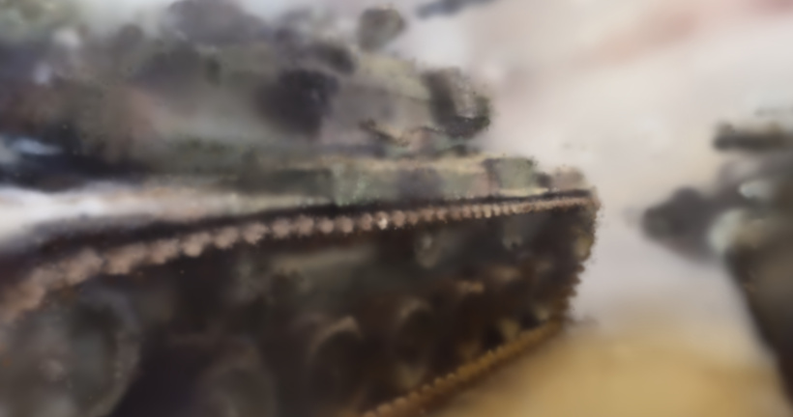
Results from M60 Tank Dataset
Key Steps:
SfM Process:
COLMAP
successfully solved camera parameters (intrinsics extrinsics) for 300 images.
Initial Point Cloud: 22.33
minutes of training resulted
in a random point cloud.
Visualization: Web-based
tools used to visualize the Gaussian splat, showing blurry results.
Adaptation: Focus shifted
to adapting for the medical
dataset with custom camera
extrinsics.
figure: Initial random point cloud generated from M60 Tank dataset.

Slide 18
Adapting to Medical Data
Initial Struggles
**Dataset Selection**: Struggled to find a suitable
dataset due to the lack of ”sliced” data for our needs.
**Raw CT Data**: Ultimately worked with raw CT slice
data, manually prepared.
Paper Selection Evaluation
Narrowed down to three key papers:
*GaSpCT*: Gaussian splatting for CT projection synthesis. *Multi-Layer Gaussian Splatting*: anatomy visualization. *Gaussian Splatting for Cinematic Anatomy*: Chose the pipeline despite some gaps.
Immersive
Each paper thoroughly analyzed by team members.

Slide 19
Adapting to Medical Data - 2
Pipeline Setup Trials
**Codebase Issues**: Faced dependency and environ-
ment issues; manual fixes required.
**Dataset Conversion**: Converted original CT dataset
(hip-CT) from JPEG2000 to PNG format.
**Pipeline Adjustment**: Implemented custom fixes for
background images and code errors.
Challenges with SfM
**SfM Challenges**: Struggled with SfM due to lack of
common features between slices.
**Alternative Dataset**: Used a tank dataset (M60,
300 images) to successfully generate camera data.
**Initial Point Cloud**: Generated Gaussian splats with
random point cloud but blurry results.

Slide 20
Key Findings
Orthographic Projection
SfM Challenges
CT
thographic projection,
not perspective.
Required a rewrite of
the camera extrinsics
script.
scans
use
or-
SfM struggles due to
the lack of common
features
slices.
Utilized an M60 tank
between
dataset
to
generate
camera extrinsics.
Gaussian Splatting Progress
Initial random point clouds generated via Gaussian splat-
ting.
Tweaked parameters (iterations, density) for better re-
sults.

Slide 21
Implications of the Findings
Impact on Medical Imaging Orthographic projec-
tion better reflects CT
scan realities.
adaptation
pipelines
Challenges for Reconstruc- tion
SfM dependency on
common features lim-
its the feasibility for
CT slice datasets.
improving handling of
images with minimal
features.
of
sup-
port medical imaging
standards.
to
Gaussian Splatting Potential
Gaussian splatting holds potential for clearer 3D visual-
ization of CT scans.
Refinements in parameters can lead to better medical
imaging techniques.

Slide 22
Acknowledging Limitations
Dataset Issues
Pipeline Testing
Limited datasets, resorted to raw CT slices.
Conversion
(JPEG2000 → .png).
Gaussian splatting gave ran- dom results.
issues
Camera
graphic
extrinsics
(ortho-
were
projection)
manually adjusted.
Codebase SfMProblems
Incompatible dependencies. SfM failed due to lack
of common features in CT
slices.

Slide 23
Suggestions for Future Research
Improving Data Compatibility
Optimization of Gaussian Splatting
Explore more medical datasets, especially DICOM.
Investigate alternative im-
age formats and preprocess-
ing methods.
Explore multi-resolution ap- proaches to improve image clarity.
Fine-tune parameters for bet-
ter convergence and detail.
Enhancing Pipeline Flexibility
Utilizing GPU-based Tools
Adapt pipeline for a wider range of imaging modalities.
Implement automated
SfM solutions for medical
datasets.
Develop optimized rasteriza- tion methods for medical datasets.

Slide 24
References
Liu, Y., Li, C., Yang, C., Yuan, Y. (2024). EndoGaussian: Gaussian Splatting
for Deformable Surgical Scene Reconstruction. arXiv preprint arXiv:2401.12561.
Zhu, L., et al. (2024). EndoGS: Deformable Endoscopic Tissues Reconstruction
with Gaussian Splatting. arXiv preprint arXiv:2401.11535.
Xie, W., et al. (2024). SurgicalGaussian: Deformable 3D Gaussians for
High-Fidelity Surgical Scene Reconstruction. arXiv preprint arXiv:2407.05023.
Li, K., et al. (2025).
Feature-EndoGaussian: Feature Distilled Gaussian
arXiv:2503.06161.
Huang, Y., et al. (2024).
Splatting in Surgical Deformable Scene Reconstruction. arXiv preprint
Endo-4DGS: Endoscopic Monocular Scene
Reconstruction with 4D Gaussian Splatting. arXiv preprint arXiv:2401.16416.
Chen, Y., Wang, H. (2024).
EndoGaussians: Single View Dynamic Gaussian
arXiv:2401.13352.
Splatting for Deformable Endoscopic Tissues Reconstruction. arXiv preprint

